Slide 1
Design efficiency and innovation an Interactive Data Visualization Project
Sumit Verma
bca V E2
07724402022

Slide 2


AGENDA
INTRODUCTION
Objective and key focus areas
Tools used
Problem Statement
Data collection
Data Cleaning and preprocessing
Key metrics for Design Efficiency
Measuring innovation
Insights and Findings
Conclusion

Slide 3

INTRO
The Design Efficiency and Innovation project aims to provide valuable insights into optimizing design processes and fostering innovation across various projects.
By leveraging data visualization techniques, this project helps stakeholders analyze key metrics such as design phase duration, cost efficiency, and innovation scores.
The goal is to enhance decision-making, reduce costs, and encourage sustainable and creative approaches in project execution, ultimately leading to improved project outcomes and client satisfaction.

Slide 4
objective
To analyze and enhance design efficiency and innovation across various projects.
Key focus areas
Optimizing design processes for better efficiency.
Measuring and promoting innovation in project execution.

Slide 5
“
Tools used
Python
Pandas
Matplotlib
Seaborn
Panel
Power BI
”

Slide 6
Problem statement
Challenges Addressed:
• Inefficiencies in design phases leading to increased costs and delays.
• Difficulty in quantifying and encouraging innovation in project designs.
Proposed Solution:
Develop a dashboard to visualize key metrics related to design efficiency and innovation, enabling data-driven decision-making.

Slide 7
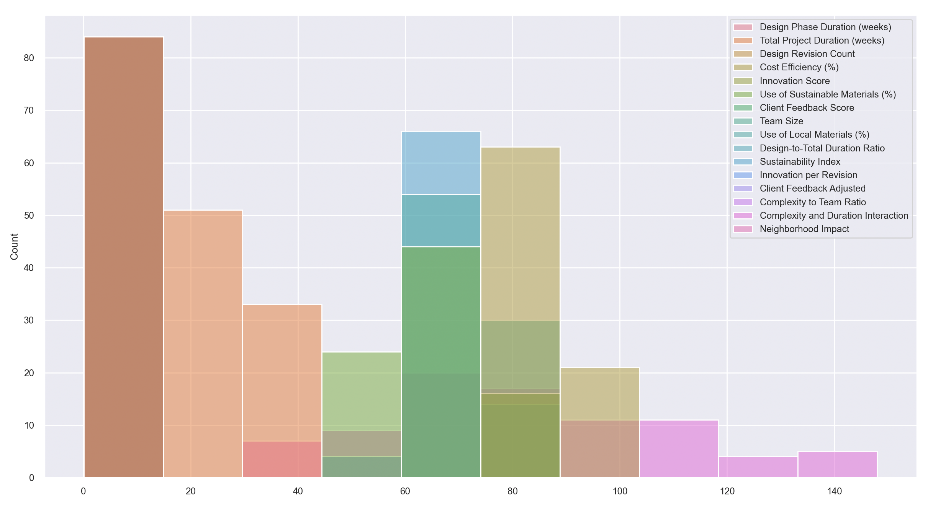
Data collection
Data Source :
Key Data Points:
CSV files with data about different projects completed in Delhi.
Later these CSV files were compiled together to perform data cleaning and preprocessing on them.
Design Phase Duration Total Project Duration
Cost Efficiency (%)
Innovation Score
Client Feedback
Use of Sustainable Materials
Design Complexity
Neighborhood (location-based insights)
Overview of Key Data Points

Slide 8
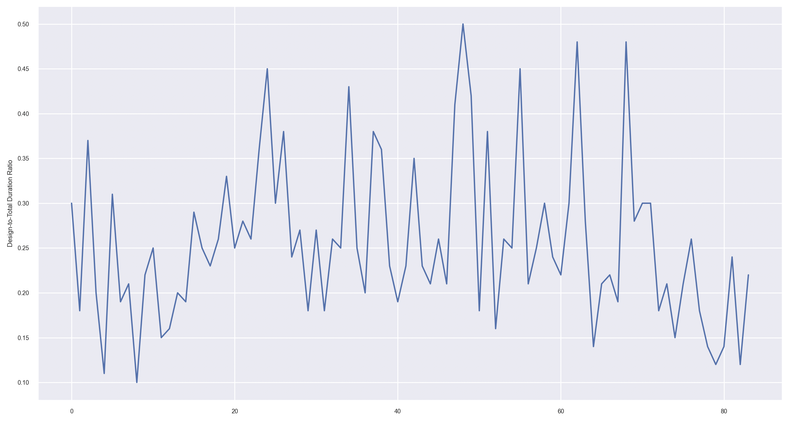
Data Cleaning and preprocessing
Steps Taken :
Handling Missing Data: Replaced missing values with column means.
Removing Duplicates: Ensured data integrity by removing duplicate entries.
Feature Engineering: Created new metrics such as Design-to-Total Duration Ratio and Innovation per Revision to provide deeper insights.
Tools :
Pandas and NumPy for data manipulation.

Slide 9
Key metrics for Design Efficiency
Design Phase Duration vs. Total Duration: Understand how efficient the design phase is in the overall project lifecycle.
Cost Efficiency:
Analyze the cost implications of design decisions.
Team Size and Complexity:
Assess the relationship between team size and the complexity of design.
Visualization Examples:
Line plots, bar charts showing design duration, cost efficiency.
(Refer to next slide for visuals)

Slide 10
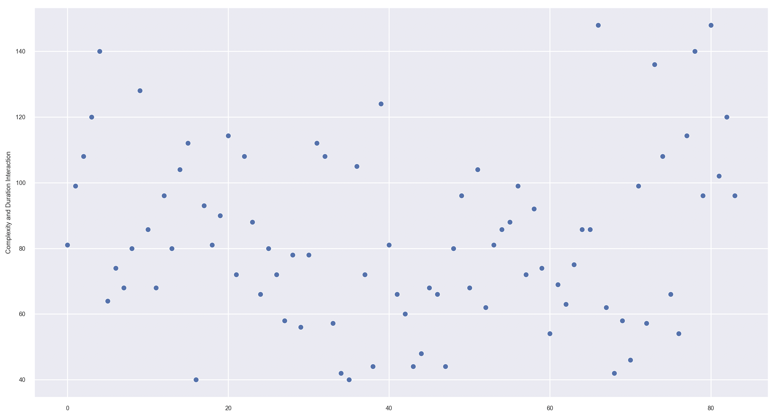
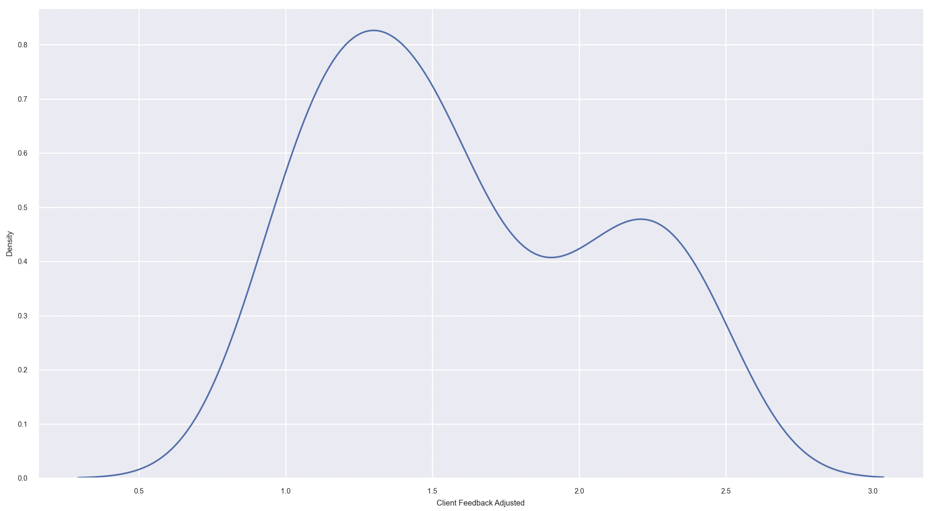
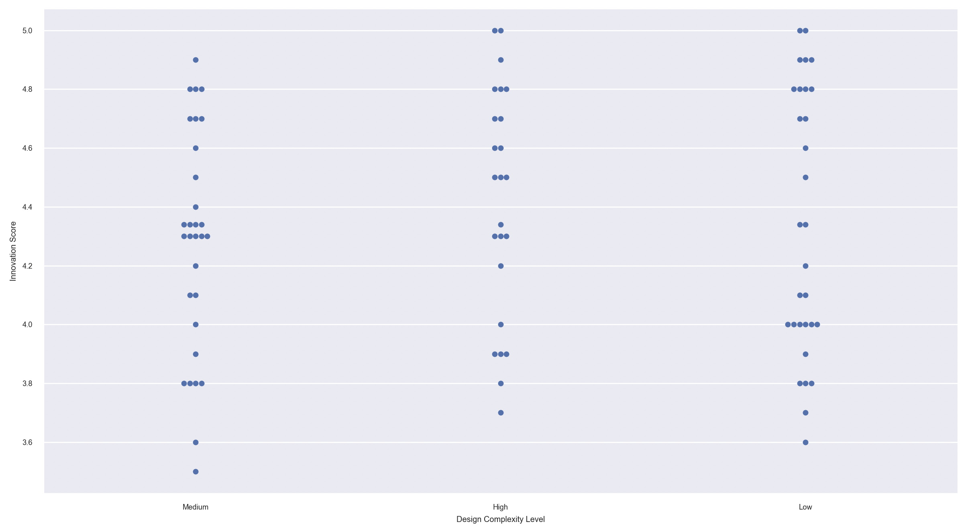
Visualization Examples:
Design-to-Total Duration Ratio
Complexity and Duration Interaction
Client Feedback Adjusted
Innovation Score and Design complexity Interaction

Slide 11
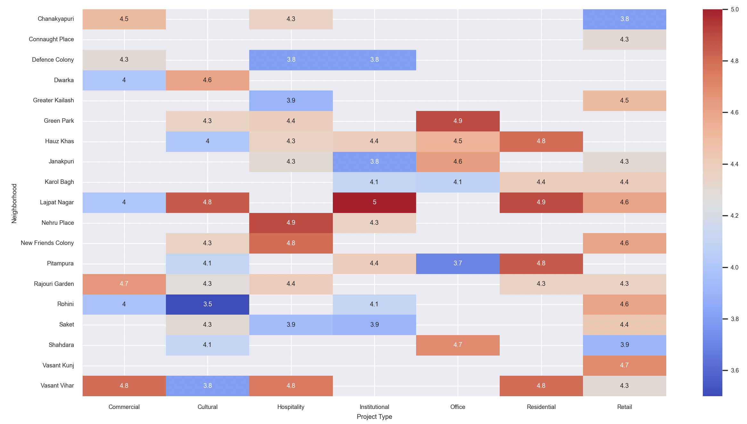
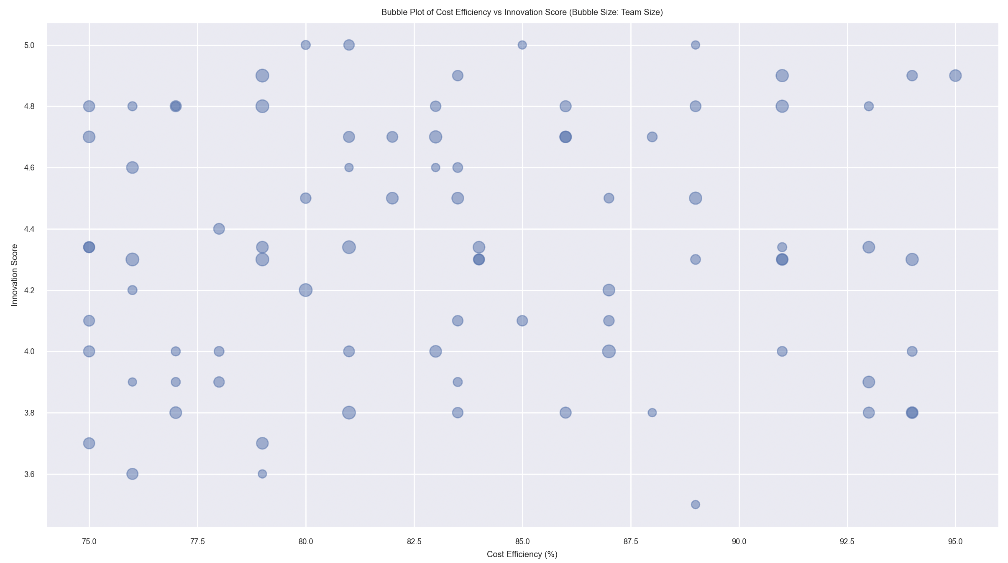
Measuring innovation
Innovation Score: Developed criteria to measure innovation in projects.
Sustainability Index: Use of sustainable and local materials as an innovation metric.
Innovation per Revision: Gauging creativity and novelty in design revisions.
Visualization Examples: Bubble plots, heatmaps showing innovation scores across different projects.

Slide 12




Insights and Findings
Design Efficiency: Efficient design phases correlate with higher client satisfaction and lower costs.
Innovation Drivers: Projects with higher innovation scores utilize sustainable materials and involve higher client feedback.
Impact of Complexity: Higher complexity often requires larger teams and longer durations, impacting both efficiency and innovation.
However, some projects were outliers and anomalies which did not follow the concluded insights.

Slide 13

Conclusion
The project provides valuable insights into improving design efficiency and fostering innovation.
Future Scope:
• Integration of predictive analytics to forecast project outcomes.
• Expansion to include more variables and additional data sources.
Impact:
Better decision-making and strategic planning for design processes.

Slide 14
THANK YOU

